Slide 1


Introduction to
Unsupervised Statistical
Analysis
Dave King PhD
Robust Design
&
Bill Messina, PhD
Supplier Quality Assurance
September 21, 2009
Copyright © 2008 Raytheon Company. All rights reserved.
Customer Success Is Our Mission is a registered trademark of Raytheon Company.

Slide 2
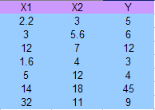

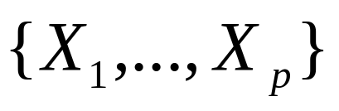

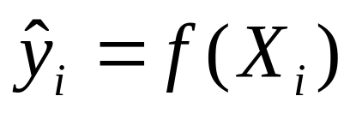
What is SUPERVISED learning?
In many statistical problems we are presented
with data which basically consists of one or
Several outputs or response variables
together with one or many input variables
The goal of statistical analysis is then to come up with an equation which best predicts
future Y values assuming one knows what the X values are. The equation which
quantifies this prediction Y = f(X) is known broadly as a model.
The task of finding a prediction is called supervised learning
or learning with a “teacher”. Under this metaphor the “student” provides an answer
for each row in the training data and the “supervisor or teacher”
provides the correct answer along with an error for each prediction that the student
provides.

Slide 3
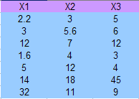
What is UNSUPERVISED learning?
Unsupervised learning is learning WITHOUT a teacher
In unsupervised learning all we are presented
with are X variables. THERE ARE NO Y VARIABLES.
The data merely consists of p columns of information
Some paradigm shifts in unsupervised learning:
1. There is no model because we need a Y to have an equation.
There is no prediction- what are we going to predict? There is no “right answer”
or “wrong answer” because no teacher to tell us that we are right or wrong.
Also, the notions “good”, “bad”, “valuable” have no meaning and
there are no error measurements either for same reason.
3. The discipline of unsupervised learning can be roughly dichotomized into:
A. Data Visualization methods: cluster analysis, principal and independent
components analysis, multi-dimensional scaling, etc etc
B. Association Rules: Aprori algorithm (Agrawal et al. 1995).
I will cover association rules here.

Slide 4
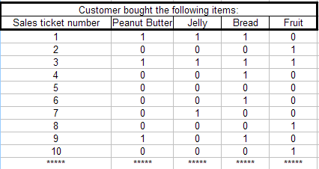
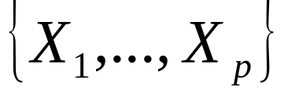
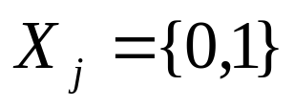
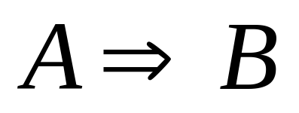
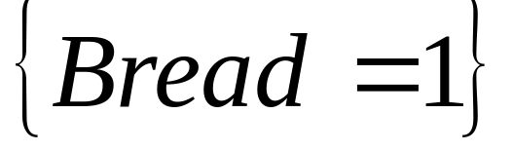
Introduction to Association Rules: Market Basket Analysis
Suppose the data consists of p columns
With each column representing a
commodity in a store
Let
With a 1 recorded if a customer bought an item and 0 otherwise.
The goal of a market basket analysis is to develop association rules which help
understand relationships between items purchased in a store.
Association rules look like:
For example:
If {Peanut Butter = 1}
And
{Jelly = 1}
THEN
This means: People who buy peanut butter and jelly also buy bread.

Slide 5
The difference between association rules and logical rules
In logic if we say:
and we can find one instance where A IS TRUE BUT NOT B
then we have disproved the rule. ➔ The rule is not true.
Statement: Everyone who buys peanut butter and jelly also buys bread
Response from skeptic: Hey, on Jan 30,1992 James bought both
peanut butter and jelly but didn’t buy bread so rule cannot be true.
In an association rules, all that needs to true is that the statement be true
be true most of the time.
Ok, so what are the qualities of good association rules?
Answer: 1. The events A and B must occur together with high frequency.
2. If you make a statement, A ➔B, you should be fairly confident your right.

Slide 6
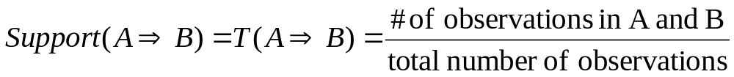
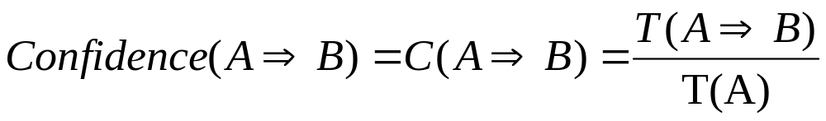
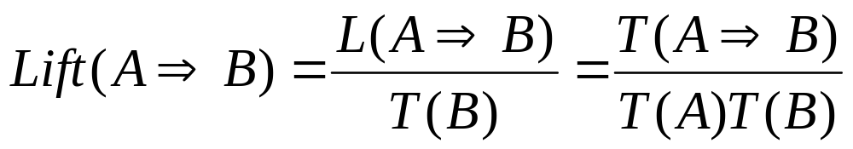
Terminology for Association Rules
For any association rule:
The set A is called the antecedent
The set B is called the consequent
The support of the rule is the fraction of observations in the dataset
meeting both criteria A and criteria B
The confidence of the rule (or predictability) is the support of the rule
divided by the support of the antecedent.
The expected confidence of the rule is the support of the consequent = T(B).
The lift of a rule is the confidence divided by the expected confidence.

Slide 7
Example of Association Rule:
Example: If { Peanut Butter, Jelly and Bread} appeared in 3% of all market baskets
The rule: {Peanut Butter = 1} And {Jelly = 1} ➔ {bread = 1}
would have support of 0.03.
A confidence value of 82% for this rule means that 82% of the time
{Peanut Butter, Jelly} are purchased {Bread} is also purchased.
If {Bread} appeared in 43% of all market baskets, then the rule
would have a lift = 0.82/0.43 = 1.95.
The goal of an association analysis is to produce
rules with high values of support and confidence.
Rules with large support are interesting to the salesman
because they occur a lot in the sales records.
Salesman desire large confidence in each rule because if A occurs
they want to be fairly certain that B will also happen.
Note that the rule B ➔ A has the same support and lift, yet a different
confidence level.

Slide 8
What software tools are there to do Association Analysis?
SAS Enterprise Miner has a association mining program
hat goes with data-mining. But SAS Enterprise miner is expensive.
R has a free association analysis package.
The package is called “arules” and is available on the web.
No matter which software you use the questions you ask the software look like this:
Display all rules that have confidence > 80% and support > 2%
Or
Display the top 1000 rules in terms of support sorted in order of confidence.
Or
Display the top x% rules in terms of confidence sorted in order of support.

Slide 9
Example of Association Analysis in R
DATASET = AdultUCI
“Adult” database from the US Census cleared for public release containing age, occupational, hours worked, education level, and income information for roughly 50,000 US households.
The database has been cleansed of any personal info which would allow someone to know the identity of anyone and has been approved for public release by US Census Bureau (It is safe).
Dataset consists of 15 columns and has 48842 rows (records).
Here are the first 3 rows of data:
Some columns {age, capital gain,capital loss, hours-per week} have numbers
Other columns are categories….
Association analysis requires every column to be categorical.

Slide 10
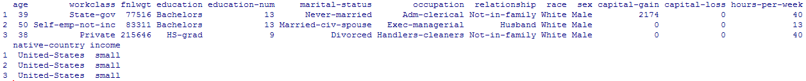
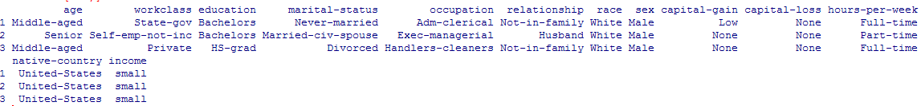
Step1: Convert number columns into ordinal categories
Before:
After:
Age was a number ➔ now a category
Every column is a factor with a certain number of levels.

Slide 11
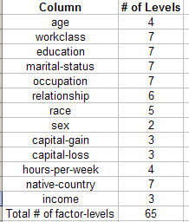
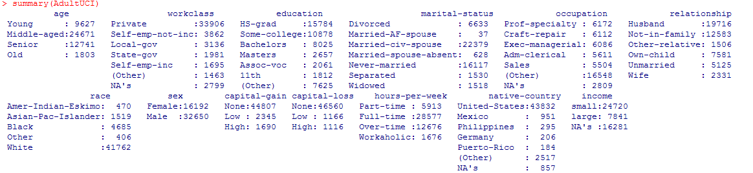
Converting to categories
Each column is now a category
The art of association analysis:
Don’t make categories too granular, because if there are too many categories, each category will have small support.
Not too few categories or you may miss granular relations
Rule of thumb: It is best to have fewer than 30 levels per factor
Helpful to summarize dataset

Slide 12



Step 2: Transform into data into transaction (or market basket) form
When the data is converted into transactions, each factor-level
becomes its own column and the data is converted to 1’s and 0’s
Example:
Before:
After:
… ➔
One line command in R
The number of columns in transaction form = # of distinct factor levels (65 in example)
Once data is in transaction form, similarities between factor-levels can
be measured on the basis of its affinity.
The affinity between factor-level A and factor-level B is measured by

Slide 13
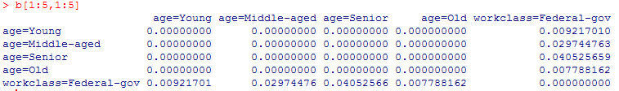
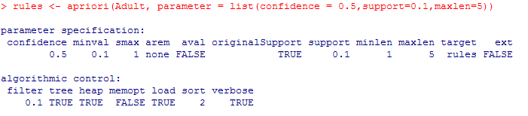
Affinity and Apriori Algorithm
In this instance, the affinity matrix is a 65 by 65 matrix
In general, the affinity matrix will be L by L where L =# of factor-levels
Next, we can run the apriori algorithm (see R code below)
Displays all rules with
confidence > 0.5
support > 0.1
And length of rule at most 5

Slide 14
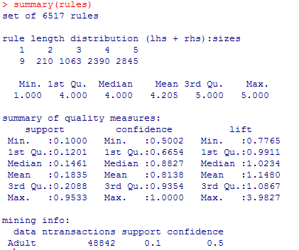
Summarize the rules
You can get a summary of rules. There are
6517 of them

Slide 15
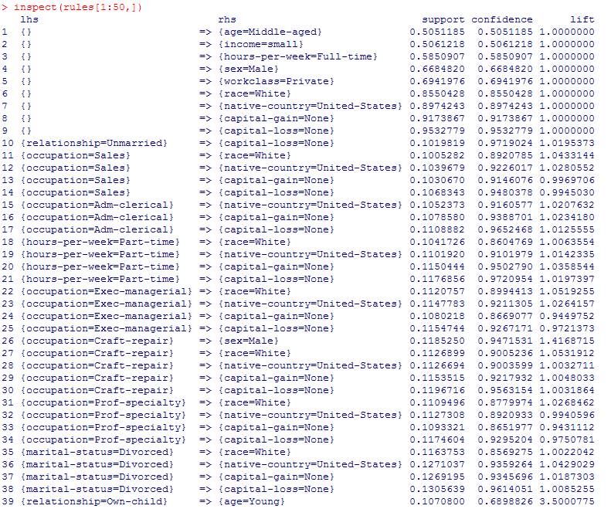
Here are the first 39 of the 6517 rules.
The results here
are sorted by support
then confidence
The lhs = antecedent
The rhs = consequent
Its possible to filter
and sort by any column
you see to the right

Slide 16
Some common complaints about association analysis
Most of the common complaints about association analysis are:
The data output produces a HUGE number of rules. Requires the analyst
To “slog through the mire” to find the “gems”
A lot of the rules fall in the “duh like I didn’t know that before category”
The output of association analysis almost requires another data-mining tool
To be applied on top of the data-mining tool.
In defense of association analysis:
You said “find all associations” and computer gave you all of them.
Computer cannot distinguish between “interesting” and “un-interesting”
associations, only humans can.
Be careful what you ask for ➔ you may get it. If you give vague instructions like
“analyze this database”, don’t be surprised by what you get.
Confucious say: The number of answers to a specific question is
small, the number of answers to a vague question is large. In fact, if
question is sufficiently vague, there maybe infinite answers.

Slide 17
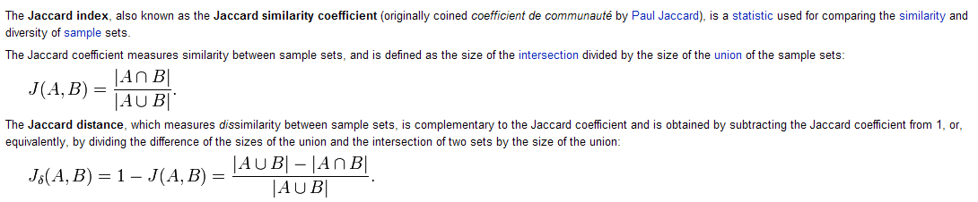

Is there any other summaries association analysis can provide?
Yes, it is possible to measure the distance between factor-levels.
Keep in mind though there is no Euclidean distance definition for “categories”.
If we think of (affinity) as a measure of “closeness”,
(1- affinity) is a measure of distance
Display the items with support > 0.05 in the “Grocery” data
This command
does hierarchical
clustering on
Jaccard distance

Slide 18
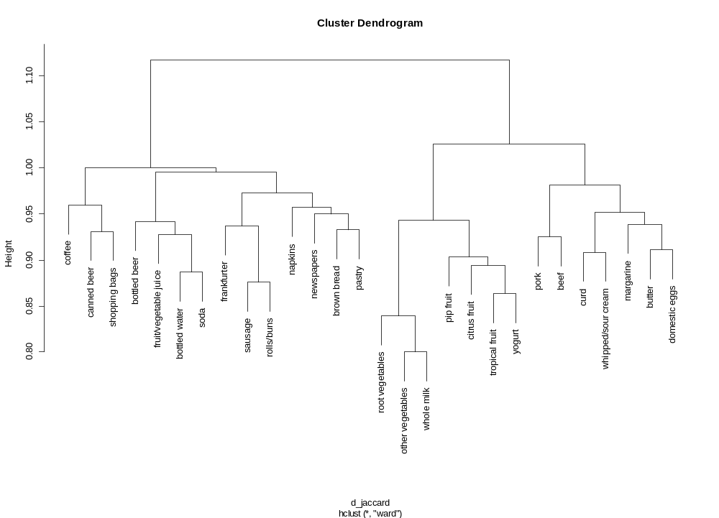
Cluster analysis on factor levels
The “Dinner shopper” category
“fast food” or “picnic” category
Recommendation from statistician: Put picnic items in one part
of store, dinner in another.

Slide 19
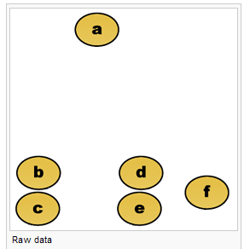
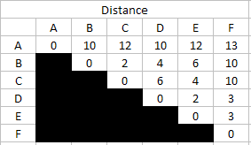
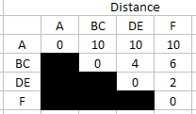


A very very brief intro to the Dendrogram
The dendrogram is a useful tool to identify clusters (points close together)
in data and works with any distance metric
Combine B
and C = BC
Cluster 1
Combine D
and E = ED
Cluster 2
Cluster 3
Dendrograms for hierarchical agglomerative clustering work by sequentially combining
the closest points together into clusters and displaying joining distance.
Join
dist
4
F
BC
DE
2
B
C
D
E
Clusters can be identified visually with Dendrogram

Slide 20
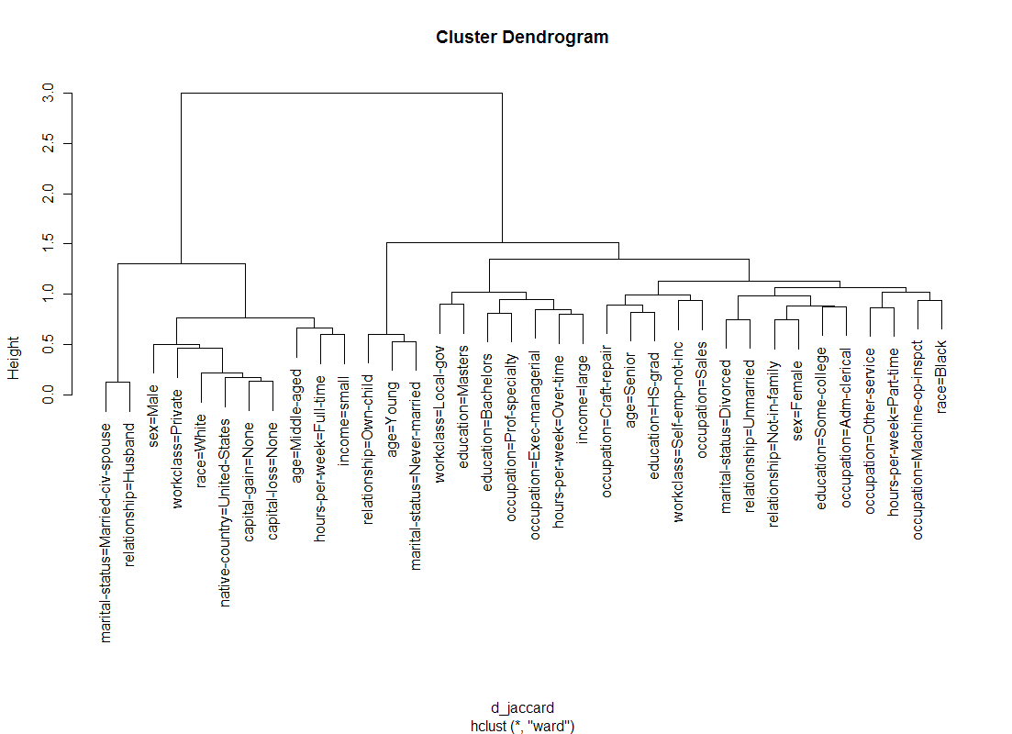
Here is the Dendrogram for US Census dataset…

Slide 21
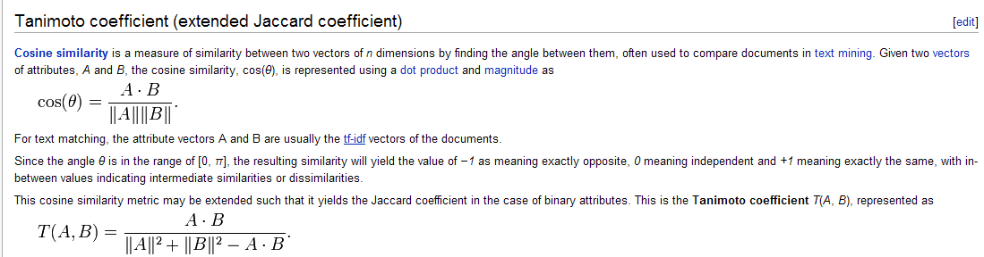
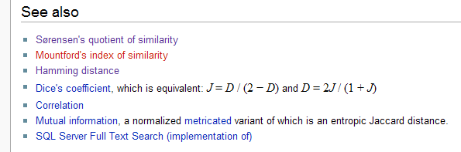
There are MANY ways to measure distance for categorical data.
Some of them are below…
Jensen’s distance is most popular, but other metrics have their applicational use

Slide 22


Another popular measure is correlation – The Pearson variety
-1<r<1
If attributes have correlation near 1, they are considered “close”
If attributes near -1 they are very far apart ➔
note this is very different from the (1-affinity) measure.
Pearson’s distance = 1-r
A popular way to display correlation is through the heat map,
Which is shown on next page.

Slide 23
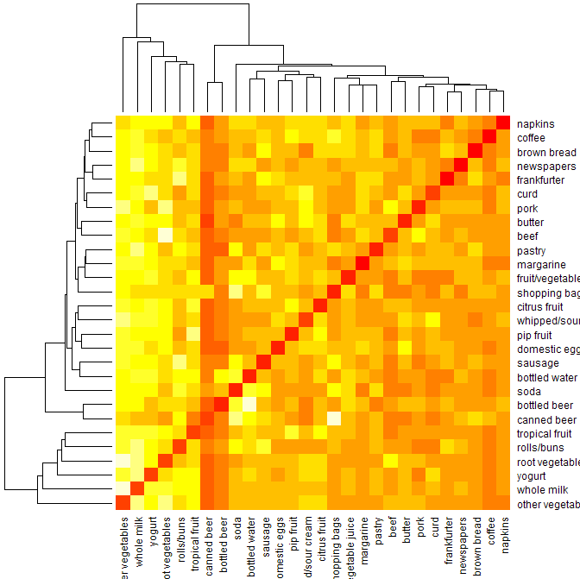
Heat map on Grocery data using Pearson’s correlation coefficient
Bright colors revel strong associations – less bright negative (or zero) ones

Slide 24
This is the tip of an iceberg.
All kinds of measures and applications have been
devised for association analysis.
If life were a Jeopardy game and the answer is association
Analysis, the question would be:
What is a tool which helps understand interrelationships between factor-levels?
Will not tell you which X’s should be made into Y’s. Humans have to do that.
95% of the work is cleaning the dataset so that association analysis can be done
Main Necessary tasks:
Decide which X’s to use – Don’t through the “kitchen sink in there”
Make sure all X variables are categorical and don’t have too many factor levels
Not a pancea – but can be very helpful.

